Slide 1
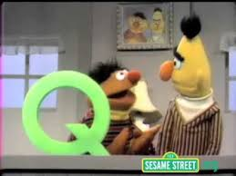

AWS Street: Brought to You by the Letter Queue
Brilliance Publishing Confidential

Slide 2
What is a Queue?
A temporary repository for messages that are awaiting processing
Acts as a buffer between a producer and a consumer
Queue
Consumer
Producer
Write
Read
Brilliance Publishing Confidential

Slide 3
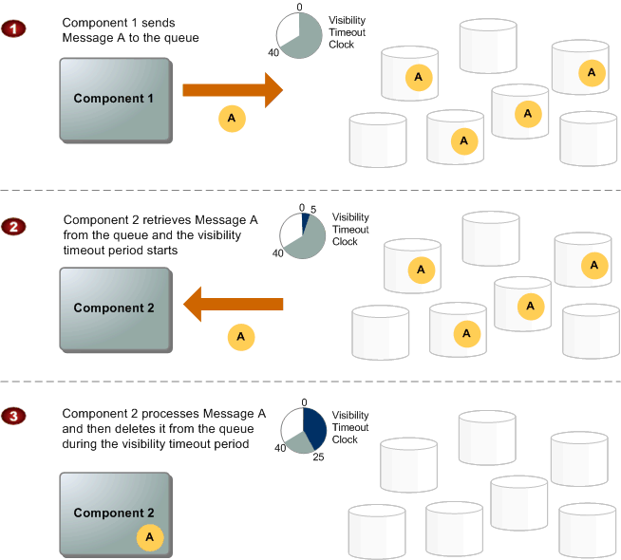
Message Lifecycle
Brilliance Publishing Confidential

Slide 4
Demo 1
Configure SQS Client
Brilliance Publishing Confidential

Slide 5
Demo 2
Send a Message
Brilliance Publishing Confidential

Slide 6
Demo 3
Send a Model
Consume a Message
Brilliance Publishing Confidential

Slide 7
Demo 4
Check for Messages
Brilliance Publishing Confidential

Slide 8
Brilliance Applications of SQS
Atticus – Ingestion Processor
Current
Proof Ingestion
DB Record created
Ingestion Processor grabs DB records in “Started” state
Processes records 1 by 1
Ingestion Processor does it again
With SQS
Proof Ingestion
Message queued
Ingestion Processor grabs message from queue
Processes record
Ingestion Processor does it again
Benefits of SQS
Spin up more Ingestion Processors under heavy load
Less data to store/mess around with
Brilliance Publishing Confidential

Slide 9
Brilliance Applications of SQS
AudiobookStand – Web Orders
Current
User places order
WebDataConduit polls for new orders
WebDataConduit processes order
WebDataConduit marks order as imported
With SQS
User places order (order is placed on queue)
WebDataConduit reads from queue
WebDataConduit processes order
Benefits of SQS
Lighter touch on production database (no updates)
Spin up more instances of WebDataConduit
Brilliance Publishing Confidential

Slide 10
Brilliance Applications of SQS
Atticus – Mass Ingestion Tool
Prepare
Discovers files
Matches TDB
User selects to process
Add Atticus records
Process Files
Standardize bitrate
Add ID3 tags
Split across discs
Clean Up
Set to Atticus to complete
Delete files
Add to Queue
Read from Queue
Add to Queue
Read From, then add to Queue
Read From, then add to Queue
Read From, then add to Queue
Read From, then add to Queue
Read from Queue
Brilliance Publishing Confidential

Slide 11

Questions?
Referenced Images
Sesame Street Q- https://i.ytimg.com/vi/f-V1aCjgzlg/hqdefault.jpg
Message Life Cycle - http://docs.aws.amazon.com/AWSSimpleQueueService/latest/SQSGettingStartedGuide/images
/MessageLifecycle.png
Sesame Street Questions - https://www.google.com/url?sa=i&rct=j&q=&esrc=s&source=images&cd=&cad=rja&uact=8
&ved=0ahUKEwiKiKvDpJXPAhUH4YMKHYjdBloQjRwIBw&url=https%3A%2F%2Fwww.youtube.com
%2Fwatch%3Fv%3DshbgRyColvE&psig=AFQjCNHX50u11AzBKbl6pKcGf6Xf0a0Pfw
&ust=1474163335552015
Brilliance Publishing Confidential

